Slide 1


Romanian NMA Training Placement Scheme
First semestrial scientific report, April 2025
Claudiu Adam, Eugen Mihuleț
Bucharest, Apr 16th 2025

Slide 2
Content of the presentation
Objectives of the program
Assumptions and constraints
Technical framework
Development and implementation
Challenges and risks
Next steps
Bucharest, Apr 16th 2025

Slide 3
Objectives of the program
Adapt and integrate COALITION-4 ML-based nowcasting system for Romania's severe weather warnings
Create a high-precision system for 0-1 hour predictions of heavy rain, hail, and lightning
Integrate multiple data sources including radar, satellite imagery, lightning detection, NWP, and Romania's DEM
Document the adaptation process and publish code on MeteoSwiss GitHub for other EUMETSAT members
Evaluate alternative AI nowcasting models alongside COALITION-4 implementation
Bucharest, Apr 16th 2025

Slide 4
Assumptions and constraints
Adapting COALITION-4 is more efficient given resource constraints
Model training limited to 2025-2026 convective seasons data due to FCI availability, NWP archive limitations, and radar product constraints
Challenge of capturing extreme weather events due to their underrepresentation in training data
Potential solution through dataset curation to maximize severe weather event representation
Geographic adaptation concerns when applying models optimized for one region to Romania's specific topographic and climatic characteristics (solution: model fine-tuning)
Bucharest, Apr 16th 2025

Slide 5
Technical framework (1) – Hardware, software, and model description
Model uses recurrent-convolutional architecture with encoder-decoder structure for multi-hazard nowcasting (lightning, hail, precipitation)
Hardware: Intel Xeon CPU, NVIDIA RTX A6000 GPU, 64GB RAM, 2TB SSD storage
Software: Python 3.12.4, TensorFlow, Xarray, Dask, scikit-learn, CuPy for GPU-accelerated processing
Data preprocessing leverages GPU acceleration to efficiently process 5-minute temporal resolution data
Initial model demonstrates performance for short-term forecasts (5-60 min), with radar data proving most valuable among input sources
Bucharest, Apr 16th 2025

Slide 6
Technical framework (2) – Data sources
Radar – generated in NetCDF format, Leonardo weather radar, 7 sites in NMA’s network
NWP – generated in NetCDF format, ICON model, 2.8 km spatial resolution
Satellite – NAT files converted to NetCDF files, FCI data, 0.5 - 2 km spatial resolution
Lightning – KML files converted to NetCDF files, LINET lightning detection network, 9 sensors in NMA’s network
DEM – GeoTIFF file converted to NetCDF file, 1 km spatial resolution
Bucharest, Apr 16th 2025

Slide 7
Development and implementation (1) – Projection and datasets
Reconfigured COALITION-4 to use Romania's Stereographic 1970 projection (EPSG:31700) instead of Swiss projection, included a 256 km buffer zone around borders to prevent boundary effects in the model's patch architecture
DEM data transformed from TIFF to NetCDF with calculated terrain derivatives (east-west and north-south slopes)
Lightning data converted from KML to NetCDF format using GPU-accelerated 8 km grid mapping (max lat and lon coordinates mapped so the distance between 2 pixels represents 8 km distance), generated binary occurrence, density, and current-weighted maps at 5-minute intervals
Acquired 12 SEVIRI data products from EUMETSAT Data Store and processed into standardized NetCDF format
NMA radar network with seven sites provides data every 5 minutes with multiple products (rain rate, reflectivity, echotops, VIL, etc.)
Using ICON 2.8km NWP model instead of COSMO due to better regional performance with 10 parameters
Bucharest, Apr 16th 2025

Slide 8
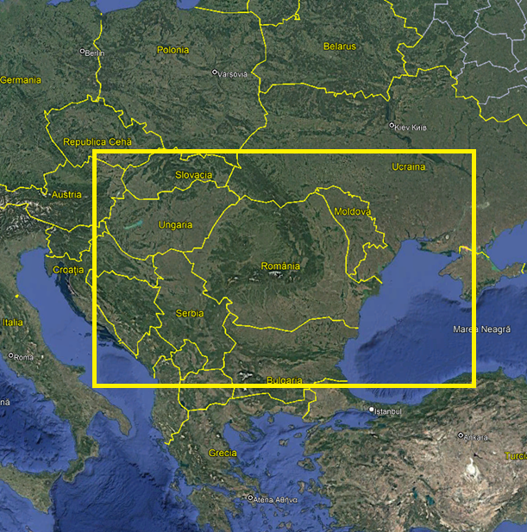
Development and implementation (1) – Projection and datasets
Area extent of model domain
Bucharest, Apr 16th 2025

Slide 9
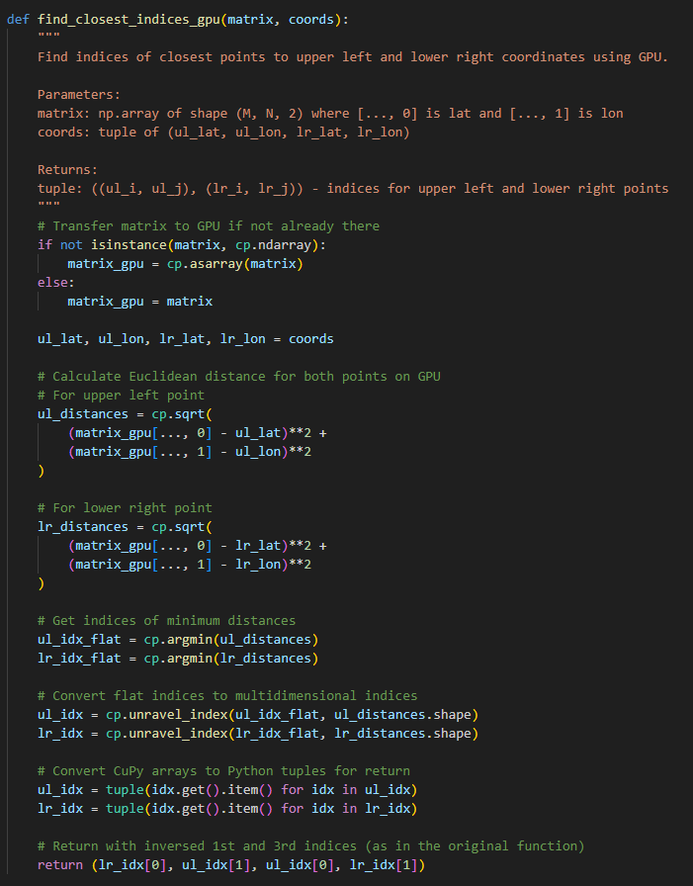
Development and implementation (2) – Patch creation and code optimization
Identifying storm cells in radar data using DBSCAN clustering and extracting 256×256 pixel patches
Aligning data sources with different resolutions through GPU-accelerated coordinate mapping and standardizing to 32×32 patches
Accelerated processing through parallel CPU operations and GPU acceleration (~1.5x faster)
Exploring SVD-based dimensionality reduction and truncated matrix approximations to balance speed and accuracy
Bucharest, Apr 16th 2025

Slide 10
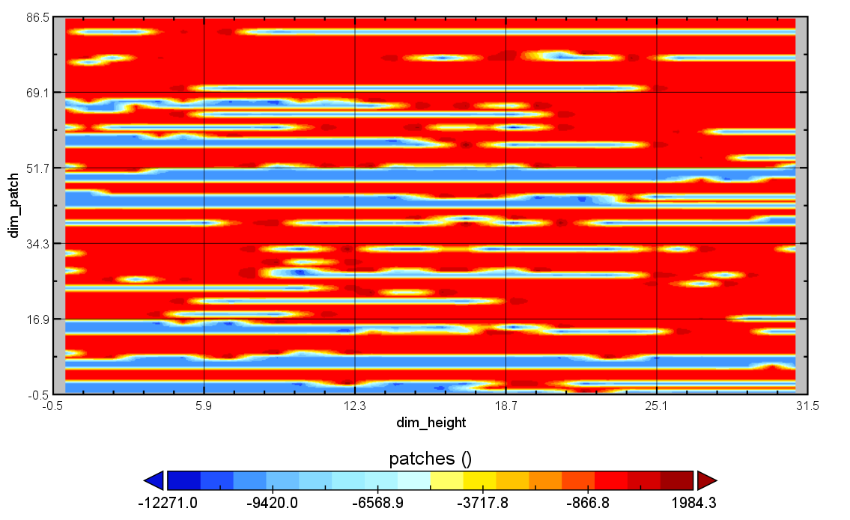
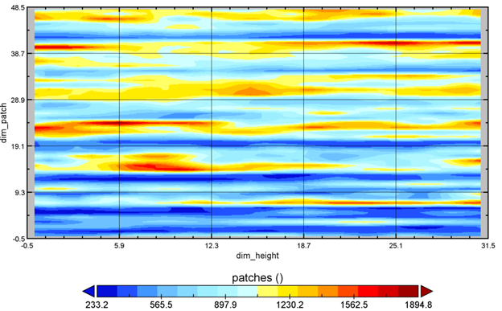
Development and implementation (2) – Patch creation and code optimization
Patches examples
Radar – RZC patches
DEM patches
Bucharest, Apr 16th 2025

Slide 11
Challenges and risks
Converting diverse data formats to standardized NetCDF with consistent spatial resolution across weather products presented a significant challenge
Planned MSG to MTG transition will require processing pipeline modifications
GPU acceleration improves processing speed but creates synchronization issues when implementing parallel CPU processing
Numerical methods (SVD dimensionality reduction, truncated matrix approximations) require balance between computational efficiency and forecast accuracy
Bucharest, Apr 16th 2025

Slide 12
Next steps
Process and integrate remaining radar and NWP products into ML model to obtain first training results
Fine-tune COALITION-4 to adapt the model to NMA data and Romanian weather patterns
Analyze product impact to potentially exclude less valuable inputs if performance remains within thresholds
Replace MSG data with newer MTG satellite data in the preprocessing pipeline
Develop physics-based model prototype to complement existing model in the prediction pipeline
Evaluate data processing for optimization needs (parallel processing, GPU operations, numerical approximations)
Bucharest, Apr 16th 2025

